Slide 1
PDF Analysis
Thomas Proffen
tproffen@ornl.gov
Neutron Data Analysis & Visualization Division

Slide 2

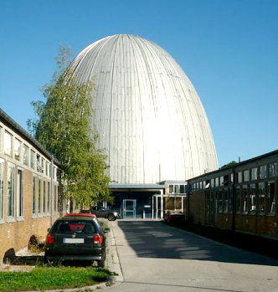
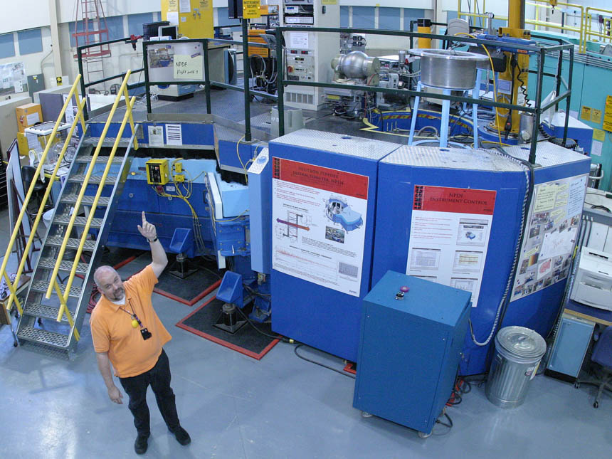
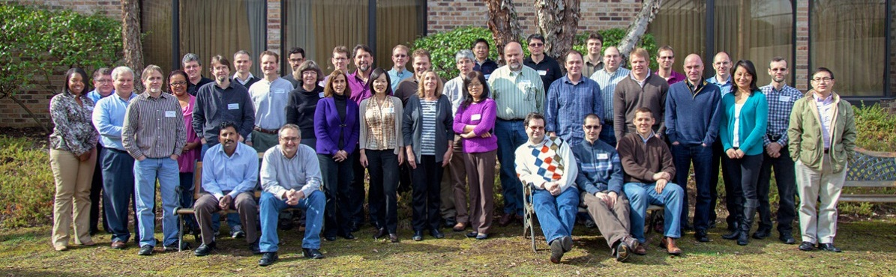
About me
My car
Forschungsreaktor
München
PhD in Crystallography from Ludwig Maximilians Universität in Munich, Germany
Postdoc at the Australian National University in Canberra, Australia
Postdoc at Michigan State University
Instrument scientist at Los Alamos National Laboratory
Diffraction Group Leader at Oak Ridge National Laboratory (SNS and HFIR)
Director Neutron Data Analysis and Visualization at ORNL.
NPDF instrument at Lujan Center (LANL)
NDAV Division

Slide 3
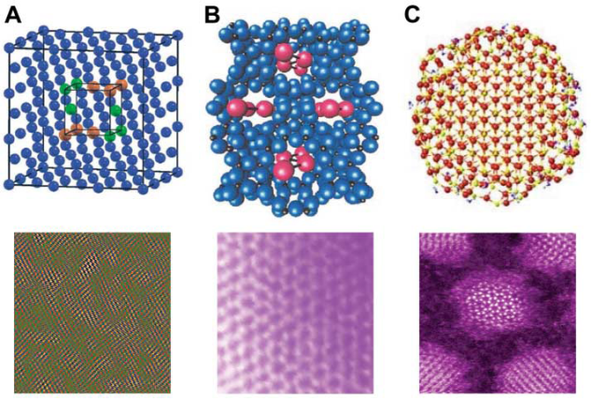
The challenge : Knowing the ‘real’ structure
Traditional crystallographic approach to structure determination is insufficient or fails for
  Non crystalline materials
  Disordered materials: The interesting properties are often governed by the defects or local structure !
  Nanostructures: Well defined local structure, but long-range order limited to few nanometers (-> poorly defined Bragg peaks)
PDF to the rescue ...
S.J.L. Billinge and I. Levin, The Problem with Determining Atomic Structure at the Nanoscale, Science 316, 561 (2007).

Slide 4

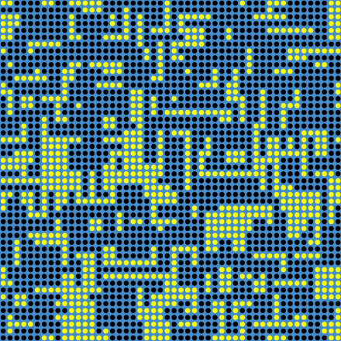
Total scattering ?
Cross section of 50x50x50 u.c. model crystal consisting of 70% black atoms and 30% vacancies !
Properties might depend on vacancy ordering !!

Slide 5
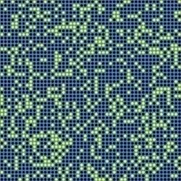
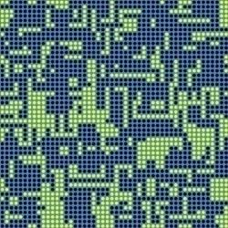
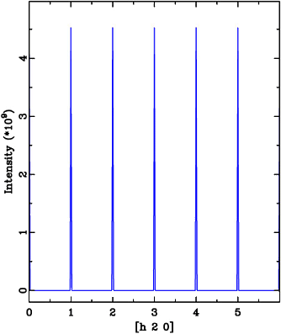
Bragg peaks are blind ..
Bragg scattering: Information about the average structure, e.g. average positions, displacement parameters and occupancies.

Slide 6
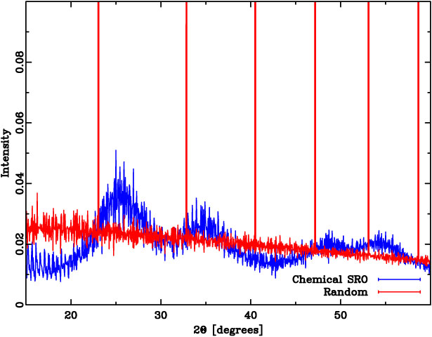
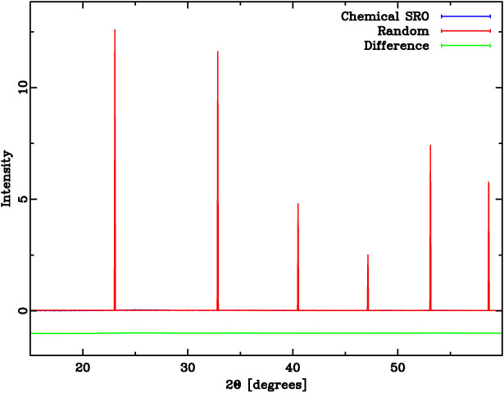
How about powder diffraction ?

Slide 7
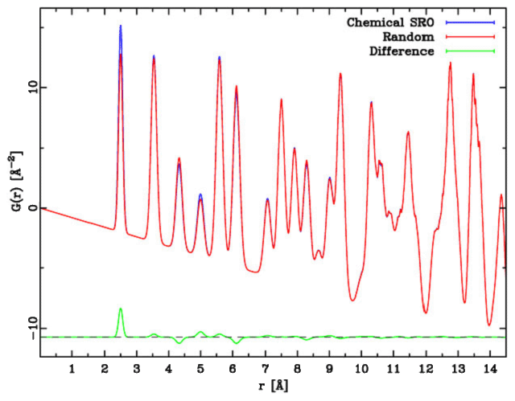
Finally the Pair Distribution Function
  The PDF is the Fourier transform of the total scattering diffraction pattern !
Proffen, Z. Krist, 215, 661 (2000)

Slide 8
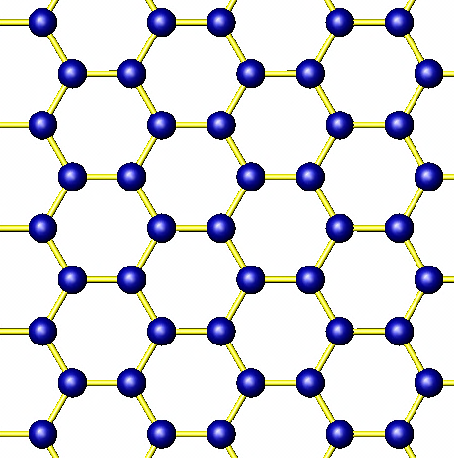
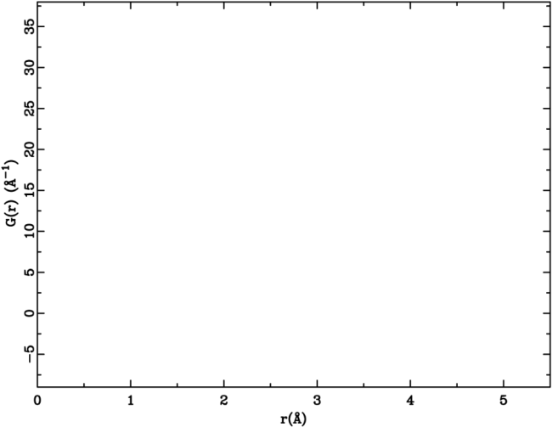
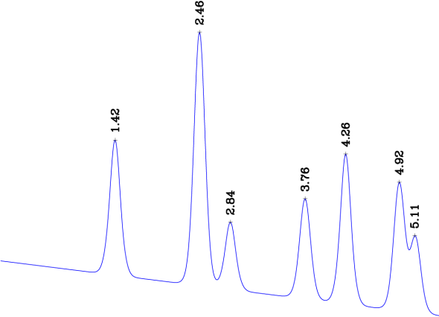
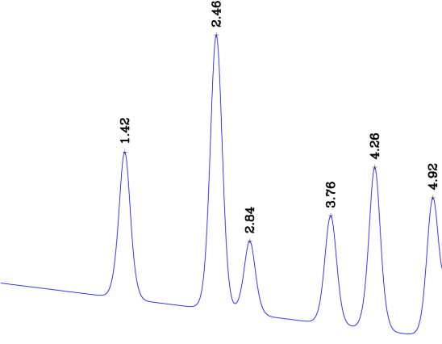
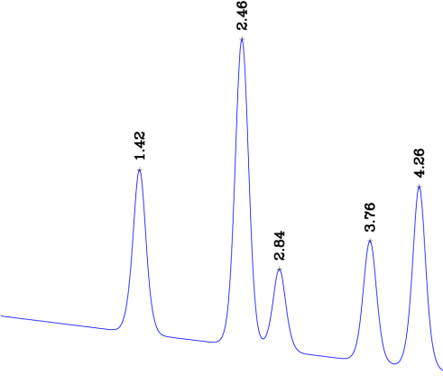
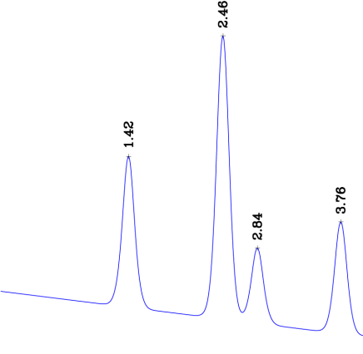
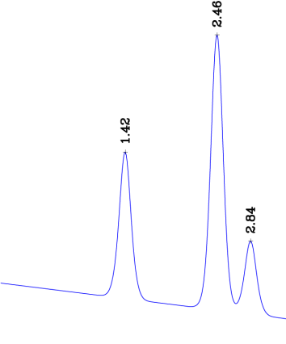
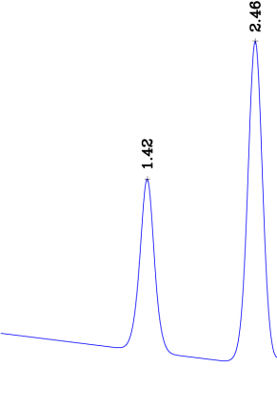
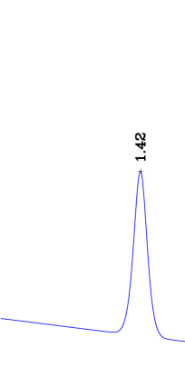
What is a PDF?
Pair distribution function (PDF) gives the probability of finding an atom at a distance “r” from a given atom.
4.26Å
2.84Å
1.42Å
2.46Å
3.76Å
4.92Å
5.11Å

Slide 9

Example:
Local structure in La_{x}Ca_{1-x}MnO₃
Simon Billinge
Emil Bozin
Xiangyn Qiu
Thomas Proffen

Slide 10
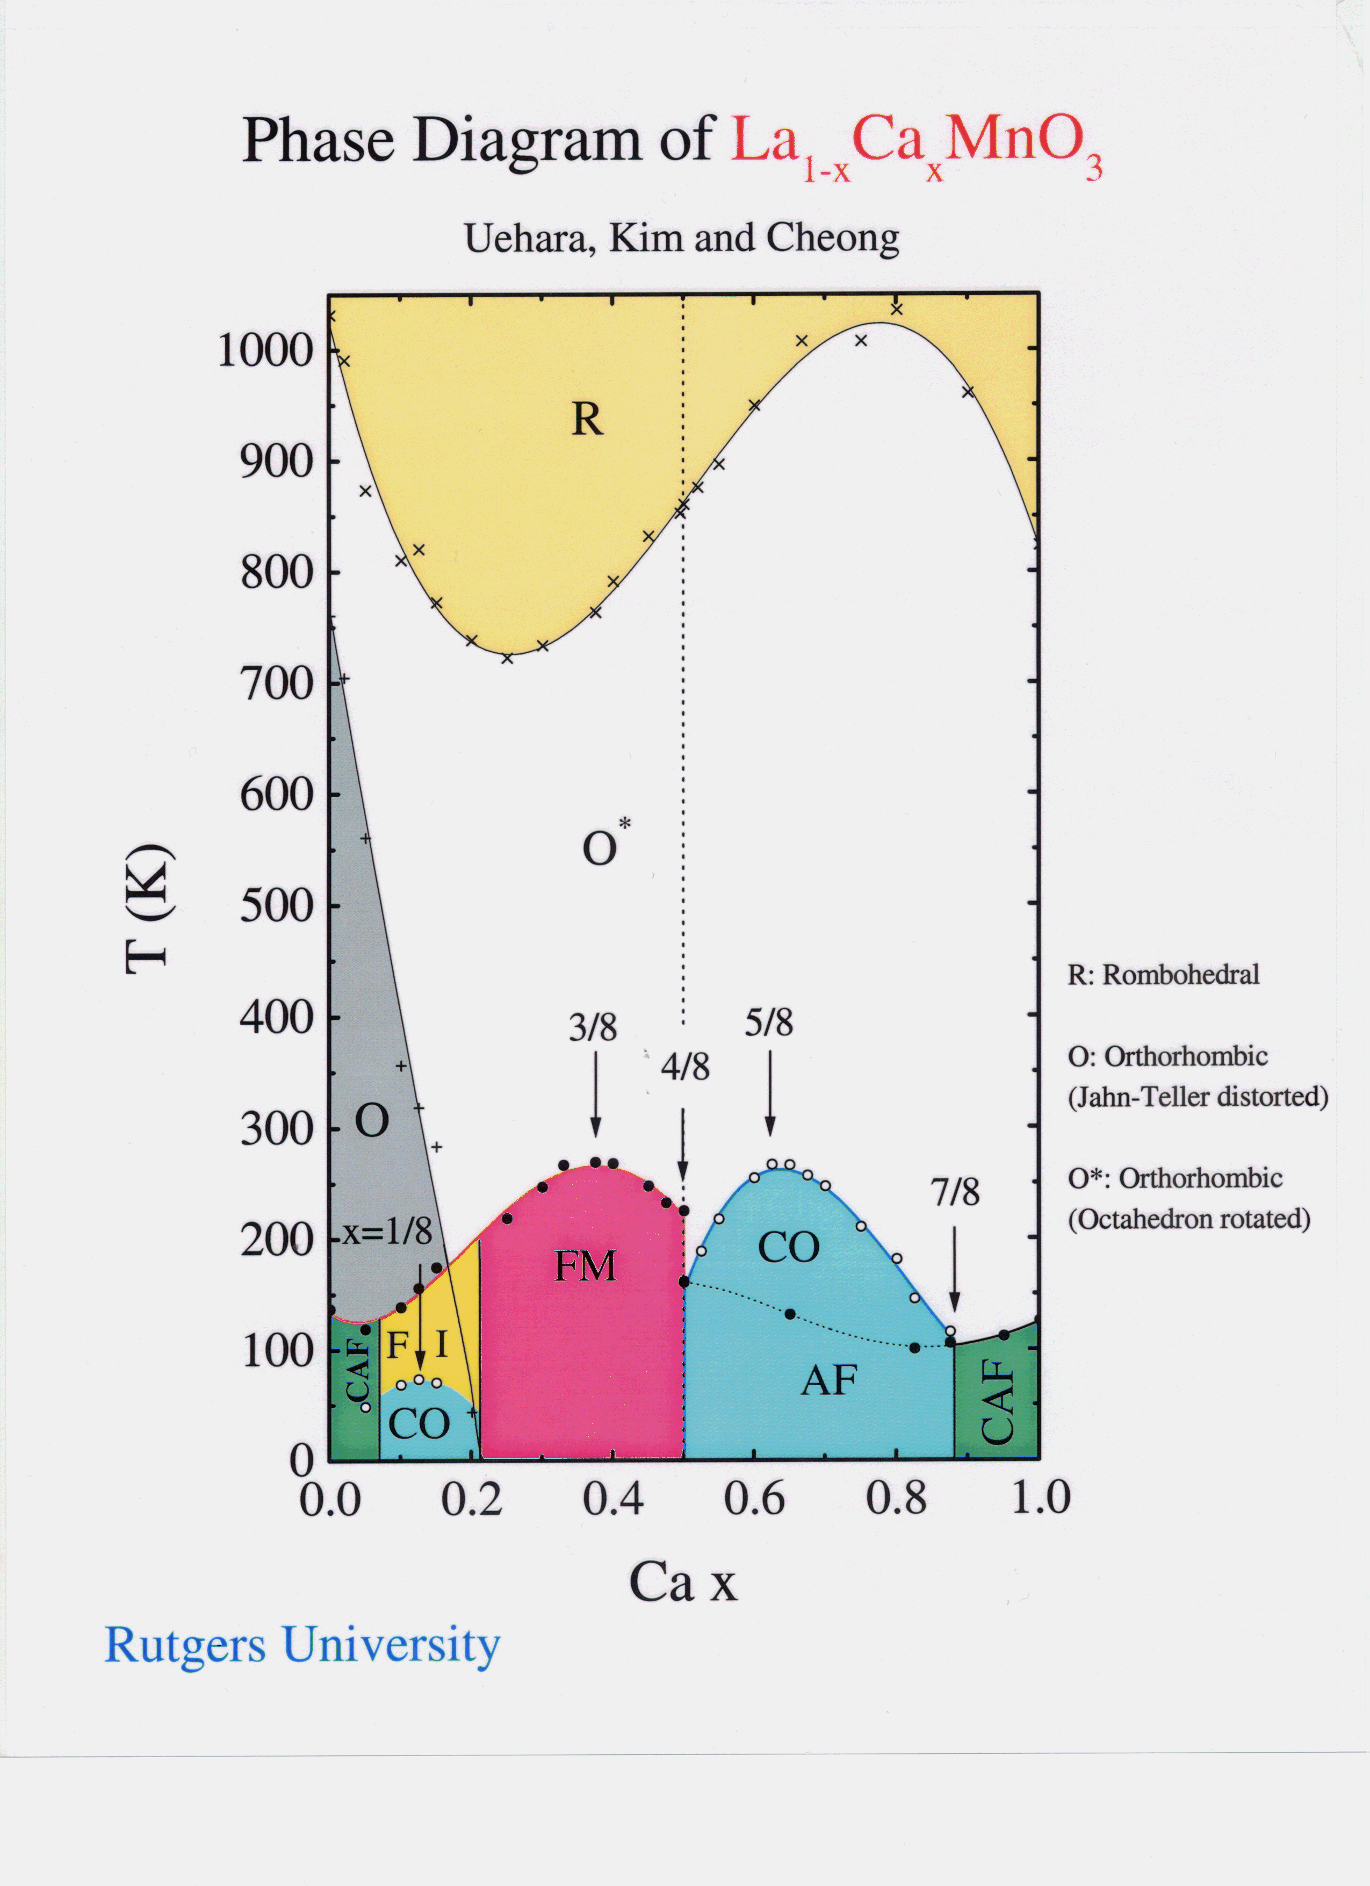
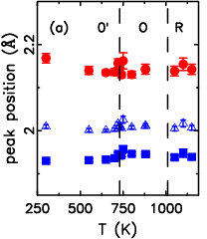
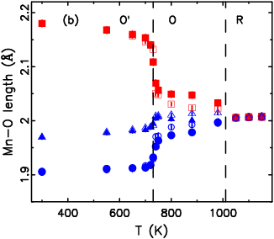
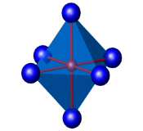
LaMnO₃: Jahn-Teller distortion
Jahn Teller
Long Mn-O bond
Local structure
Average structure
Mn-O bond lengths are invariant with temperature, right up into the R-phase
JT distortions persist locally in the pseudocubic phase
Agrees with XAFS result: M. C. Sanchez et al., PRL (2003).

Slide 11
Refinement as function of
atom-atom distance r !
X. Qiu, Th. Proffen, J.F. Mitchell and S.J.L. Billinge, Orbital correlations in the pseudo-cubic O and rhombohedral R phases of LaMnO3, Phys. Rev. Lett. 94, 177203 (2005).

Slide 12
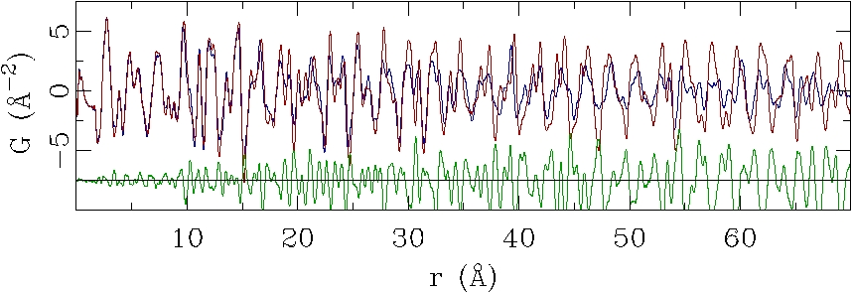
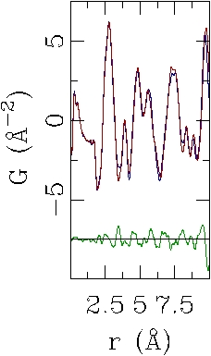
LaMnO₃: Simplicity of the PDF approach
700 K data (blue) vs 750 K data (red)
30s
Distortions persist locally!
Notes:
This is a great plot. I think it would be stronger if you limited the range to say 15 so the Ir-Ir peak disappearance is amplified. It is in-your-face evidence…you don’t need to say any more. Forget the modeling, everyone will believe it if you just show the data! Well, don’t forget the modeling, put it in, but you get my meaning…really play this aspect up as it is great something like this can really be seen in the “raw” data.

Slide 13

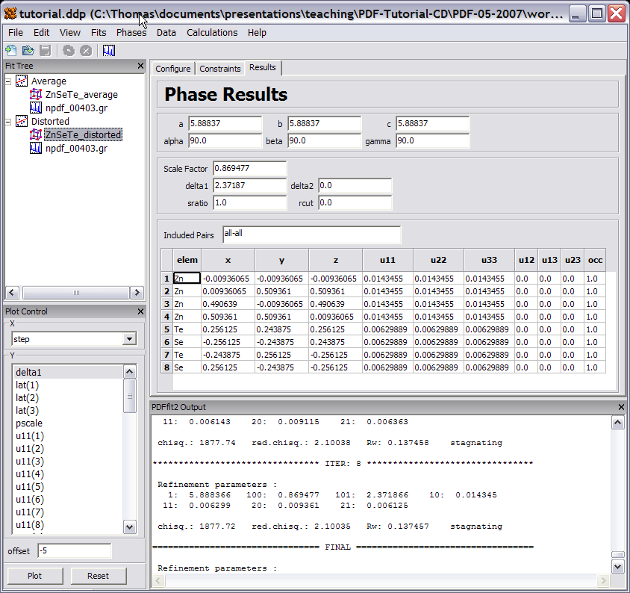
Software: Data modeling
PDFgui
Part of DANSE project.
http://www.diffpy.org/
Calculation and refinement of small model system (< 1000 atoms)
‘Rietveld’ type parameters: lattice parameters, atomic positions, displacement parameters, ..
New possibilities: Refinements as function of r range !
Automatic refinement of multiple datasets as function of T or x.
Intuitive GUI.
Engine pdffit2 can also be used in command mode.

Slide 14


Slide 15
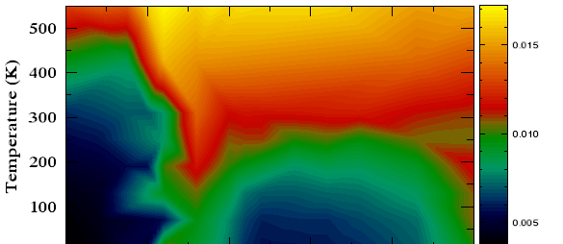
La_{1-x}Ca_{x}MnO₃: Phase diagram
Atomic displacement parameter (ADP) for Oxygen
(measure for thermal and static deviations from site)
PI
FM
Phase diagram draws itself from the parameters.
Unexpected detail emerges and demands interpretation.

Slide 16
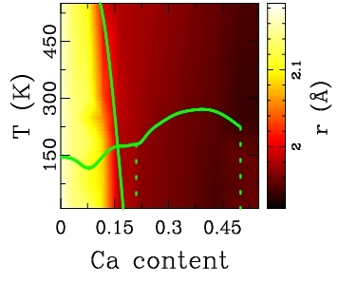
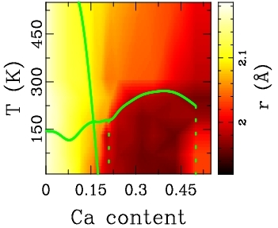
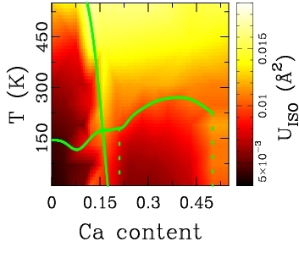
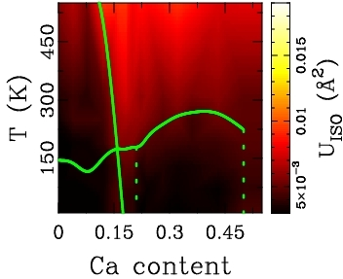
La_{1-x}Ca_{x}MnO₃: Phase diagram
Average structure
Local structure
Mn-O
long bond
ADP
Oxygen

Slide 17
Example
Investigation of the structure and stability of SnO₂ nanocrystal and its surface-bound water
H.-W. Wang¹, D. J. Wesolowski¹, T. E. Proffen², A. I. Kolesnikov², L. Vlcek¹, W. Wang³, M. Feygenson², J. O. Sofo⁴, L. F. Allard Jr.⁵, and L. M. Anovitz¹
BES/Geosciences Program-Geochemical Equilibria and Reaction Dynamics: Atomic- to Pore-Scale Processes (ERKCC72)

Slide 18
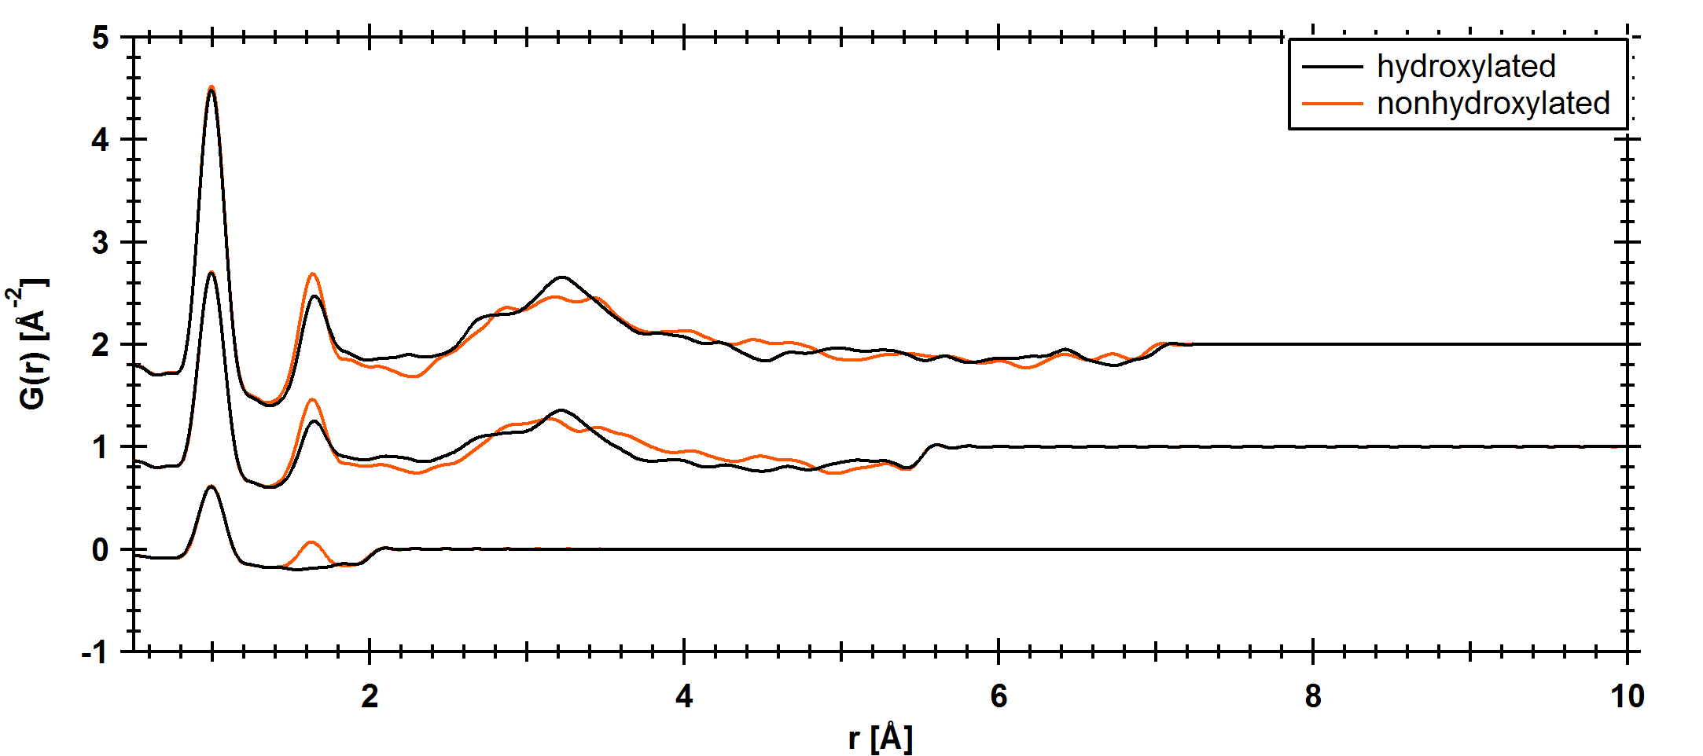
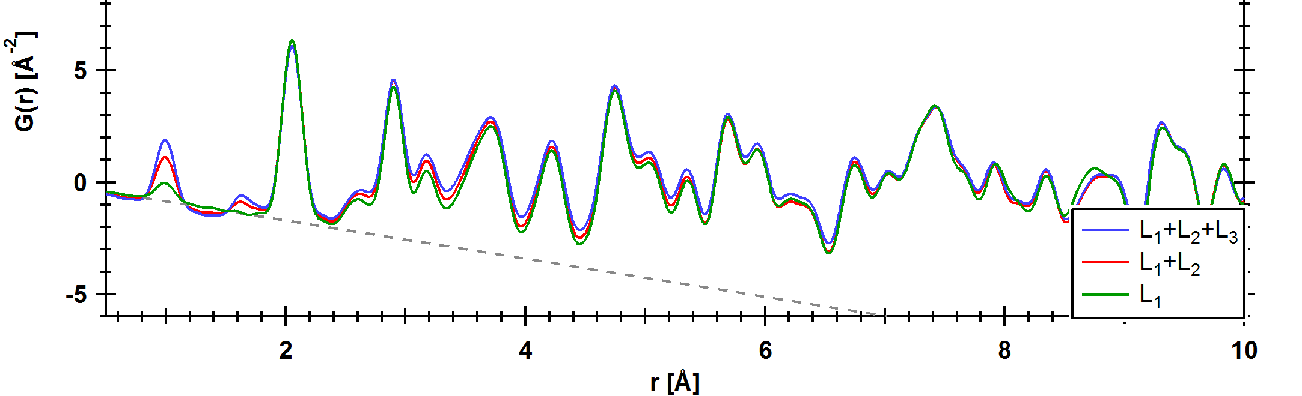
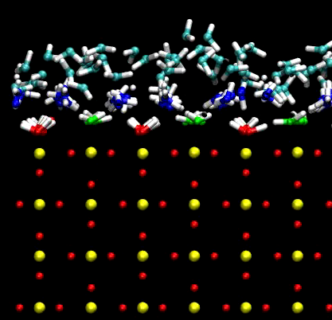
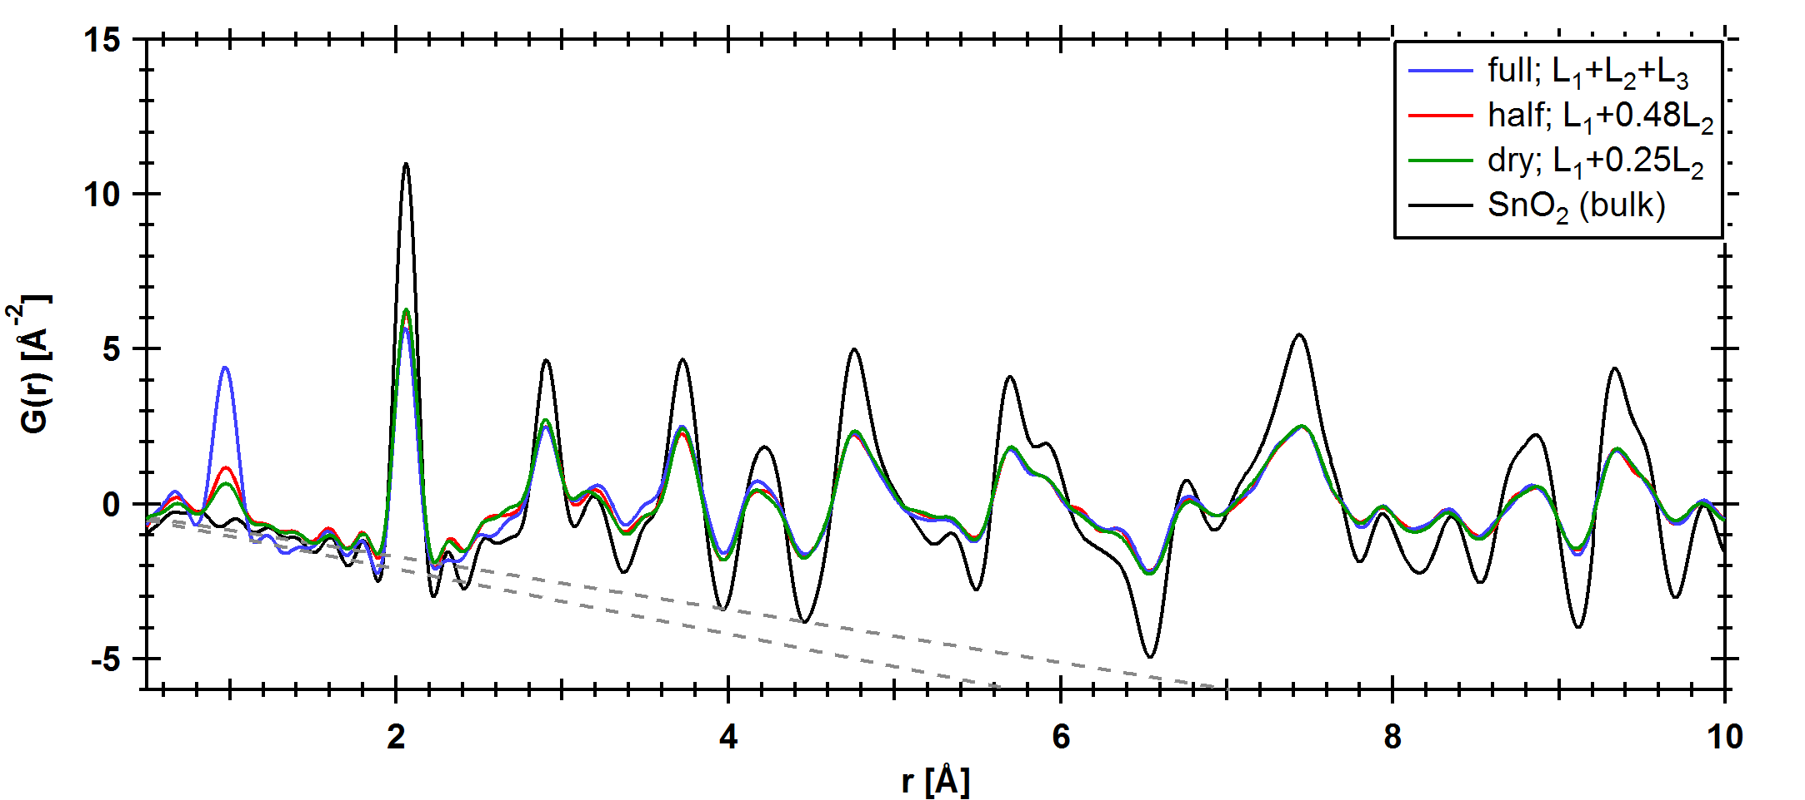
MD and PDF
MD: hydration layer only
PDF for nonhydroxylated and hydroxylated models:
Box size: 41 x 41 x 23 Å³ ; 2592 atoms; # density = 0.068 Å⁻³;
U_{iso} = 0.003 Å²;
1st coord. shell - 1:O-D; 2:D-D; 3:Sn-O; 4/5/6:O-O and Sn-Sn (c axis);
2nd coord. shell - 7/8:Sn-Sn, Sn-O, and O-O; 9: Sn-Sn (a and b axes)
L₁ +L₂ +L₃ : 41 x 41 x 8 Å³
L₁ +L₂ : 41 x 41 x 6 Å³
L₁ : 41 x 41 x 2.5 Å³
MD: SnO₂ + hyd. layer (hydroxlated model)
1
2
0.068
Observed PDF
3
1
5
7
9
6
8
4
0.084
0.068
Notes:
HUMP…..
Nonhydroxylated model not as consistants with PDF because of D-D peak.

Slide 19
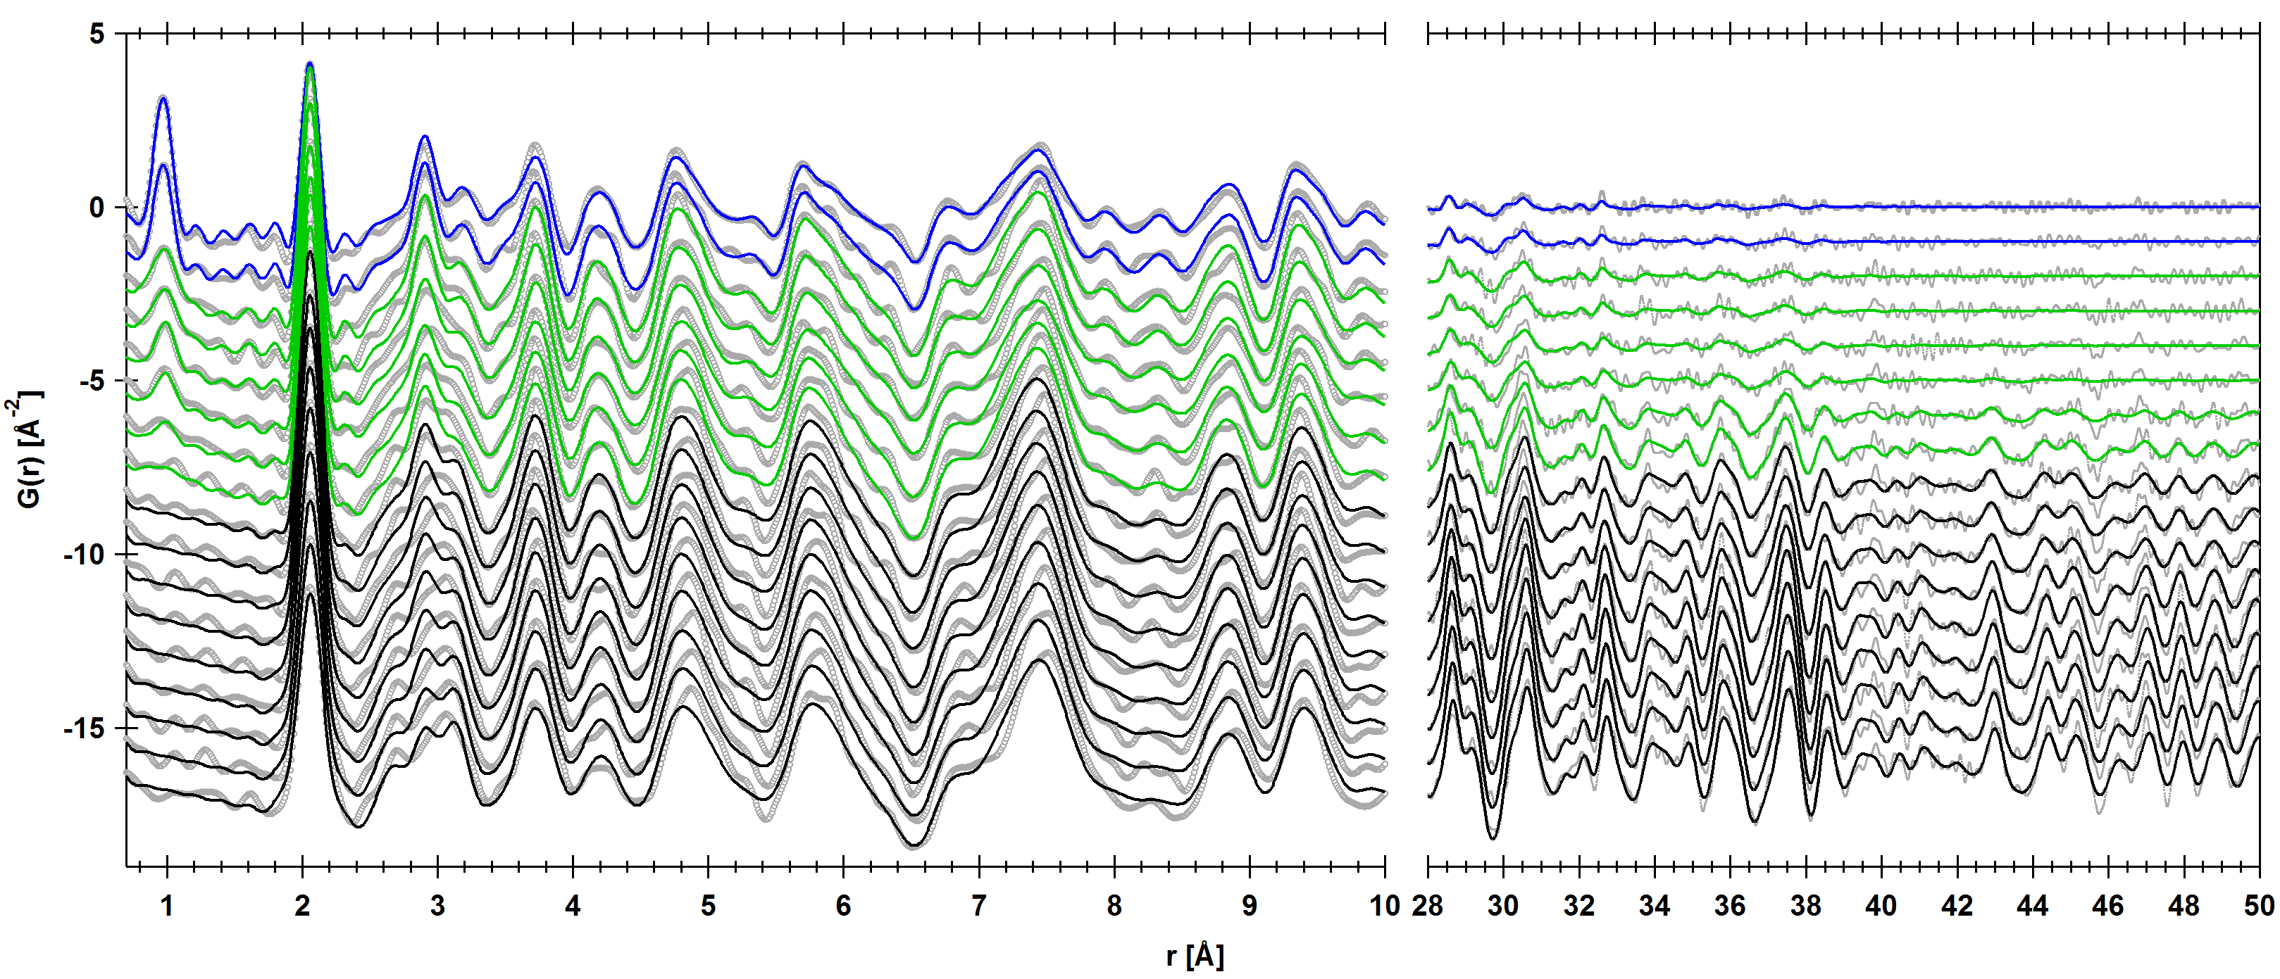
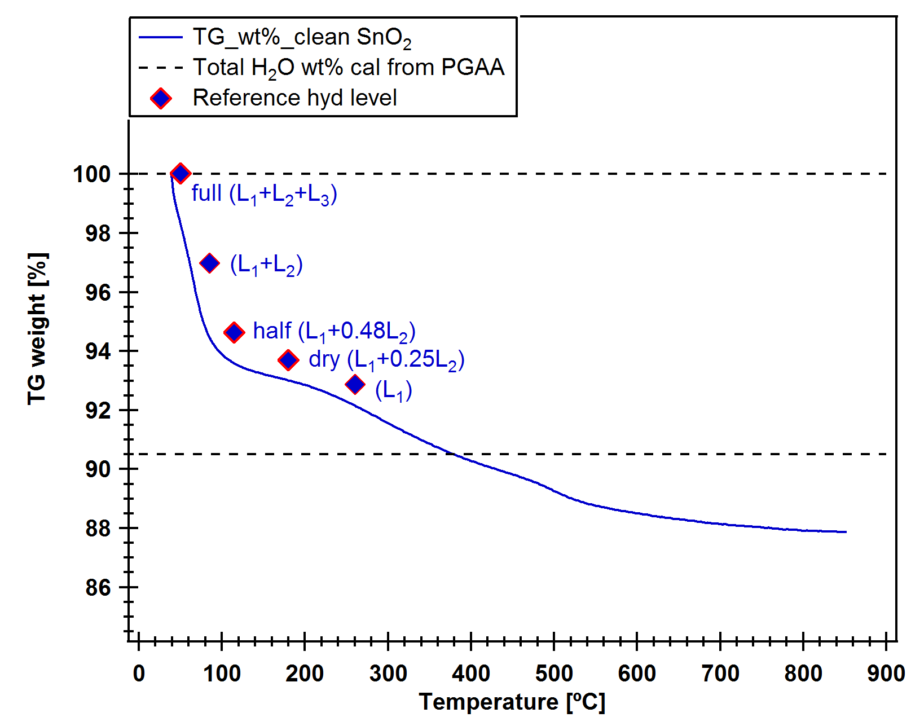
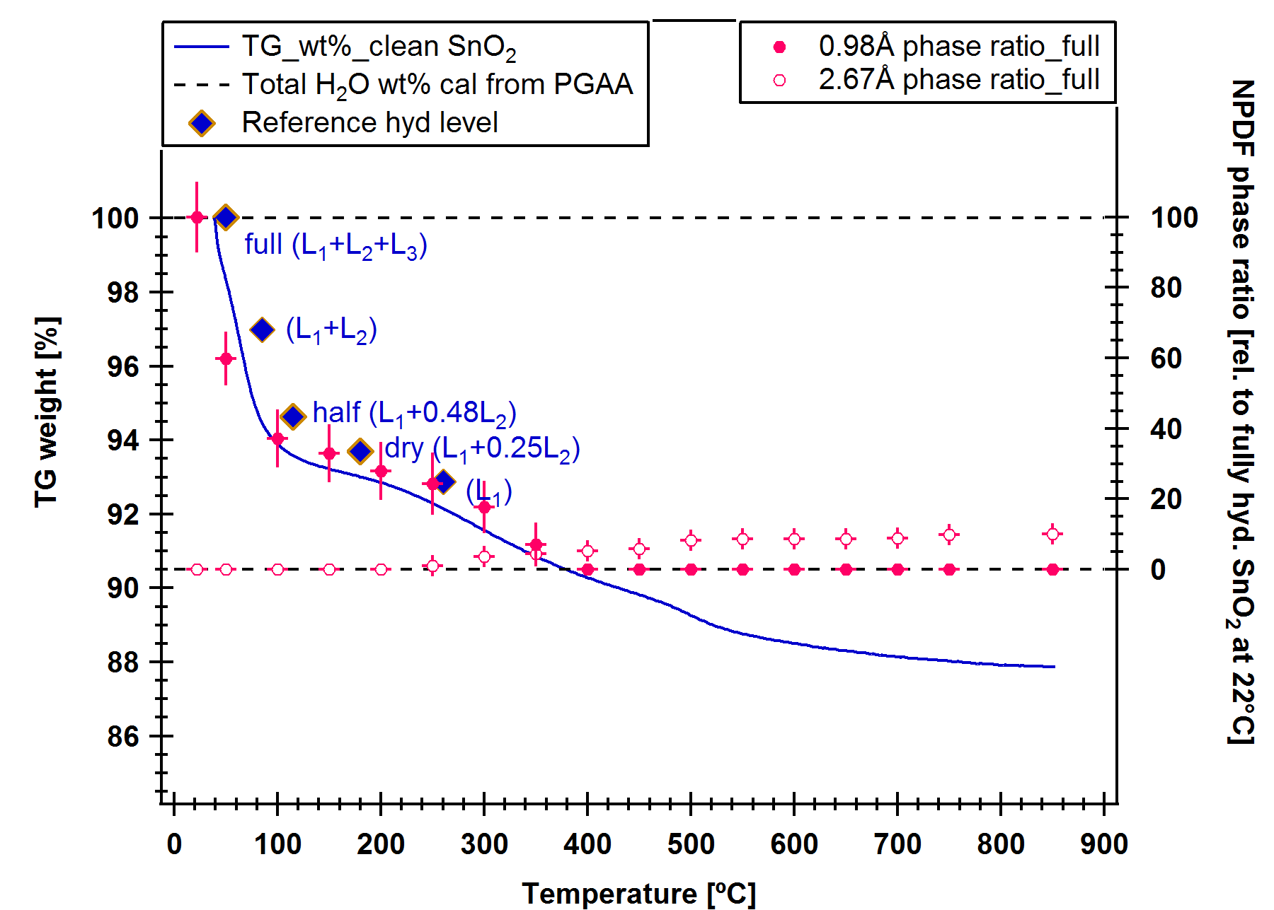
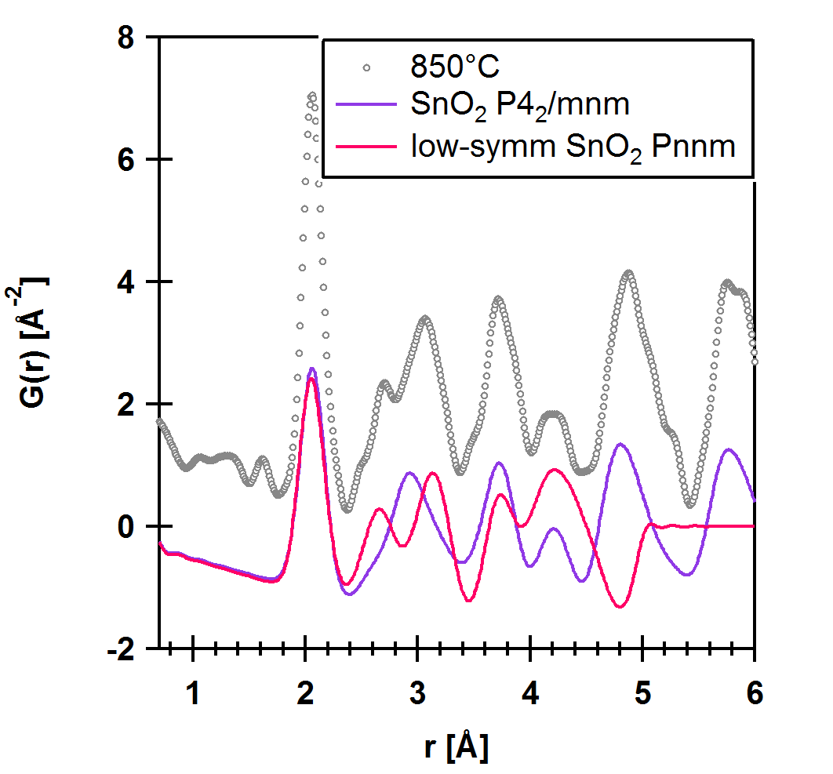
PDF in-situ dehydration (cont.)
22 ºC
TGA
9.49%
850 ºC
2.65%
1.61%-Cl ; 1.04%-O
19
Notes:
Distorted model to describe any related surfaces modifications, including loss of O, Cl, misorientation, twinning and microstrains arises from grain growth.

Slide 20

Example:
“Complete” structure of
Gold Nanoparticles
Katharine Page
Ram Seshadri
Tony Cheetham
Thomas Proffen

Slide 21
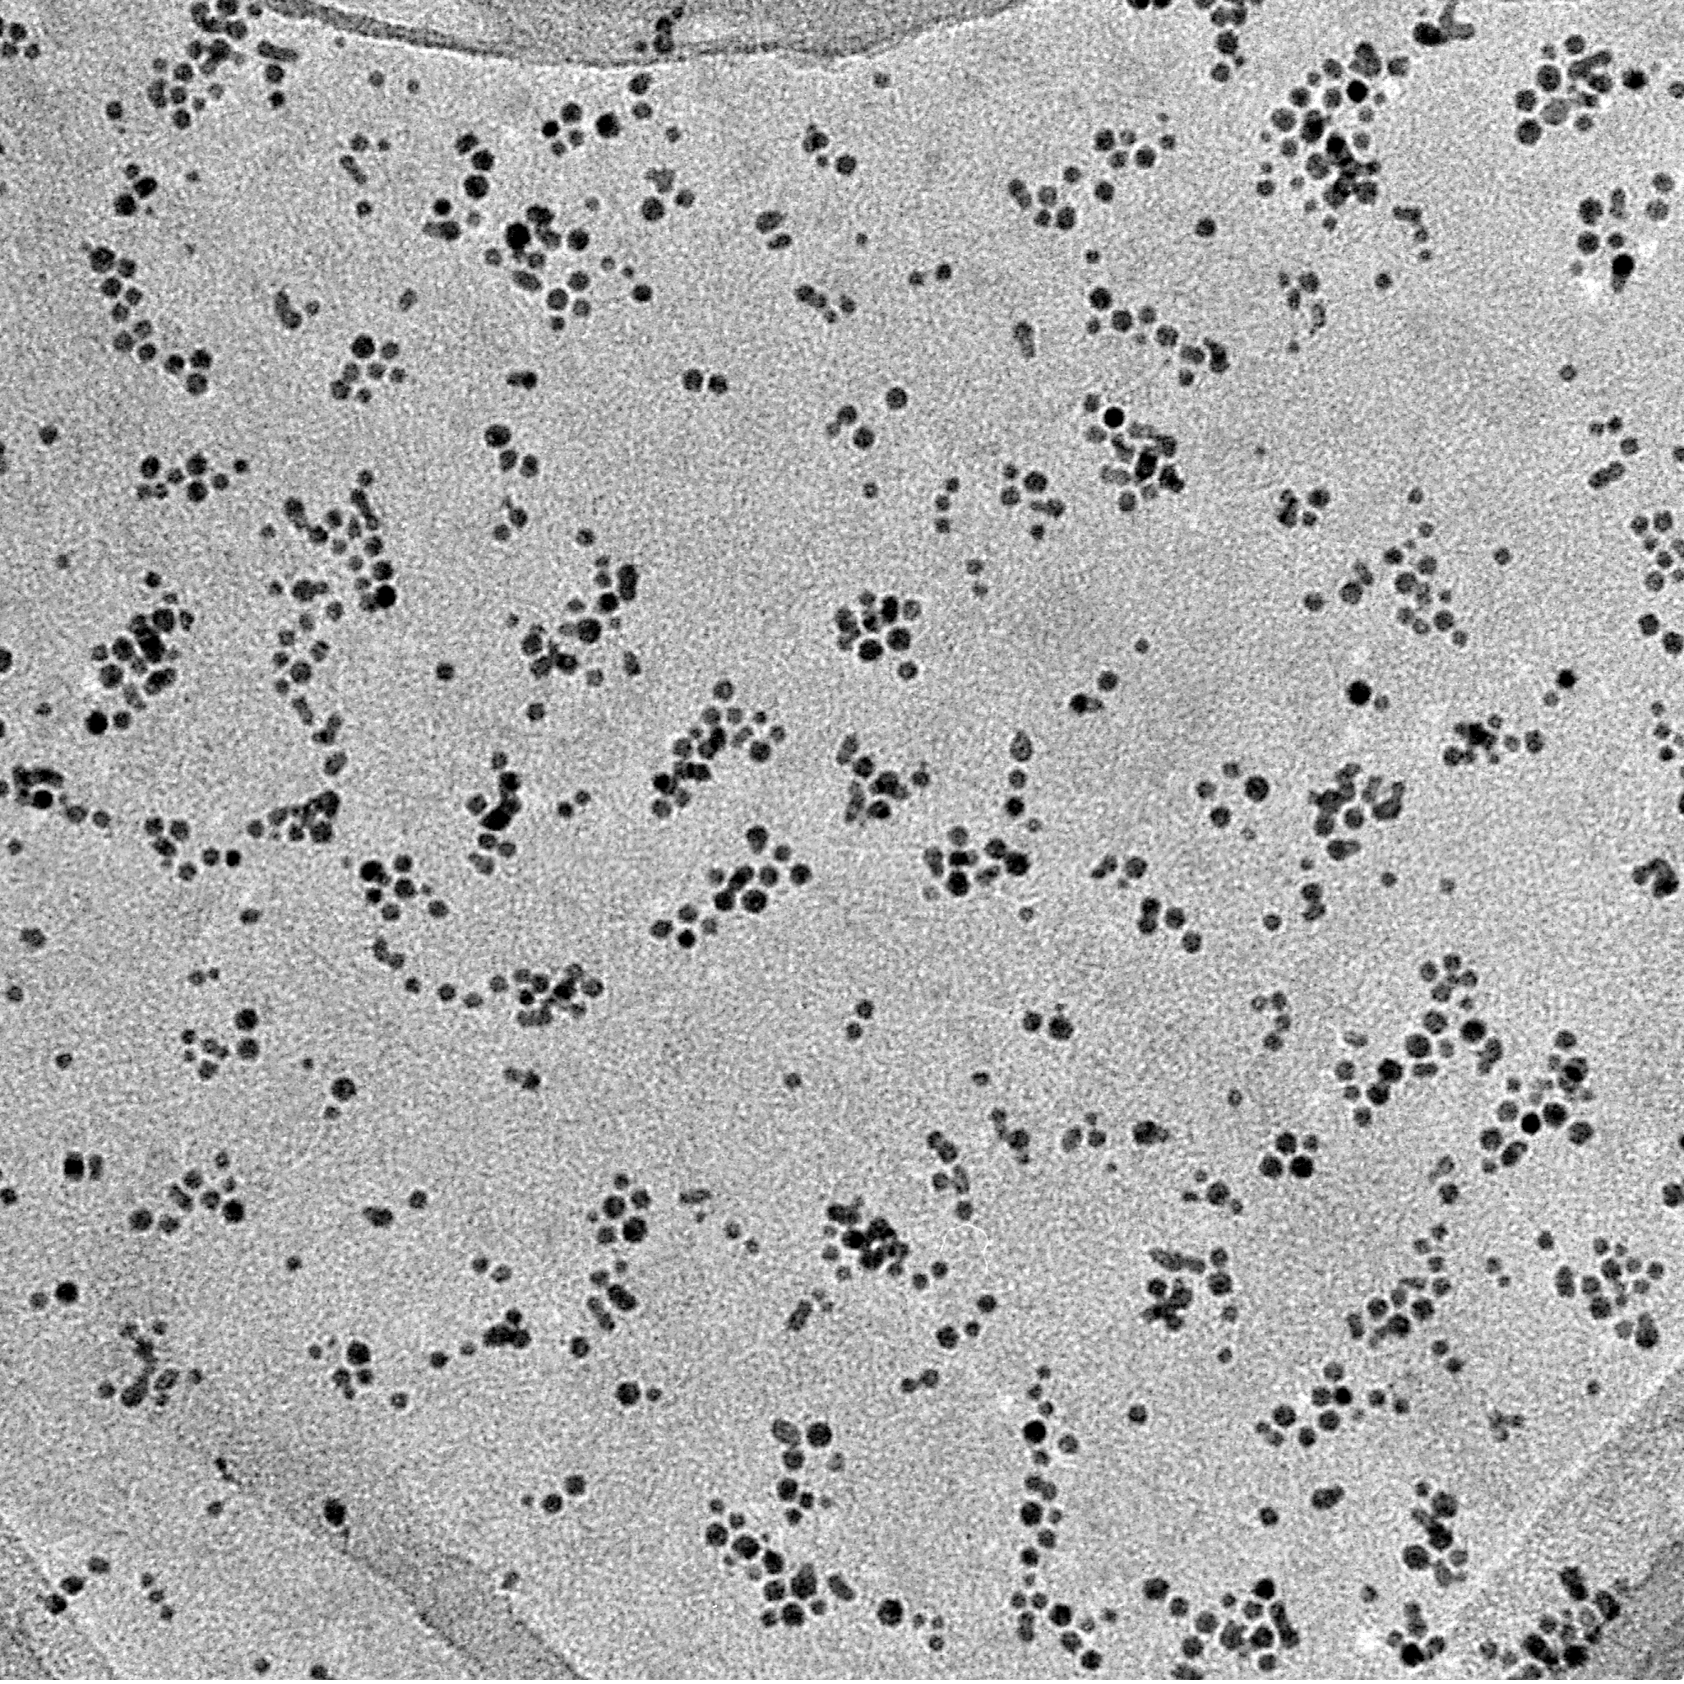
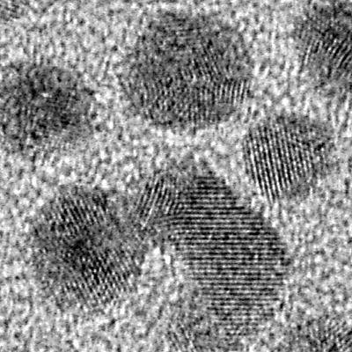
Gold nanoparticles
Nanoparticles often show different properties compared to the bulk.
Difficult to study via Bragg diffraction (broadening of peaks).
PDF reveals “complete” structural picture – core and surface.
This study:
  5nm monodisperse Au nanoparticles
  1.5 grams of material
  Neutron measurements on NPDF
2nm
50 nm

Slide 22
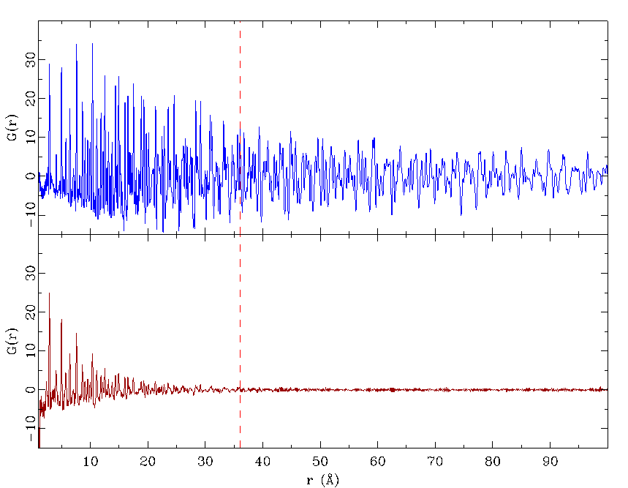
Gold nanoparticles: First NPDF data
Bulk gold
K.L. Page, Th. Proffen, H. Terrones, M. Terrones, L. Lee, Y. Yang, S. Stemmer, R. Seshadri and A.K. Cheetham, Direct Observation of the Structure of Gold Nanoparticles by Total Scattering Powder Neutron Diffraction, Chem. Phys. Lett. 393, 385-388 (2004).
Gold nanoparticles
Average diameter ~3.6nm

Slide 23
Nanoparticles: Particle size
Nanogold
Instrument resolution
Spherical particle envelope

Slide 24
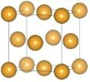
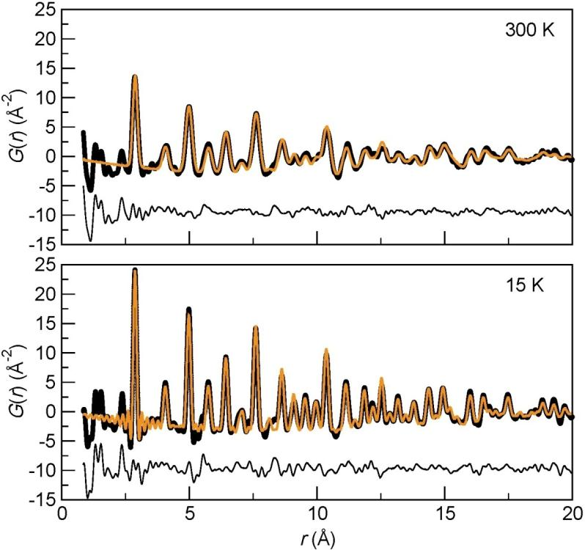
Modeling Au structure only
300 K: R_{w} = 33.8 %
scale = 0.2121(5)
a = 4.0753(1)
u_{iso}(Au) = 0.01267(6)
δ1 = 1.980(7)
d = 26.13(7) Å
15 K: R_{w} = 27.8 %
scale = 0.2070(4)
a = 4.06515(5)
u_{iso}(Au) = 0.0044(2)
δ1 = 2.257(5)
d = 25.54(4) Å
This is the conventional PDF nanoparticle approach… no ligand modeling.

Slide 25

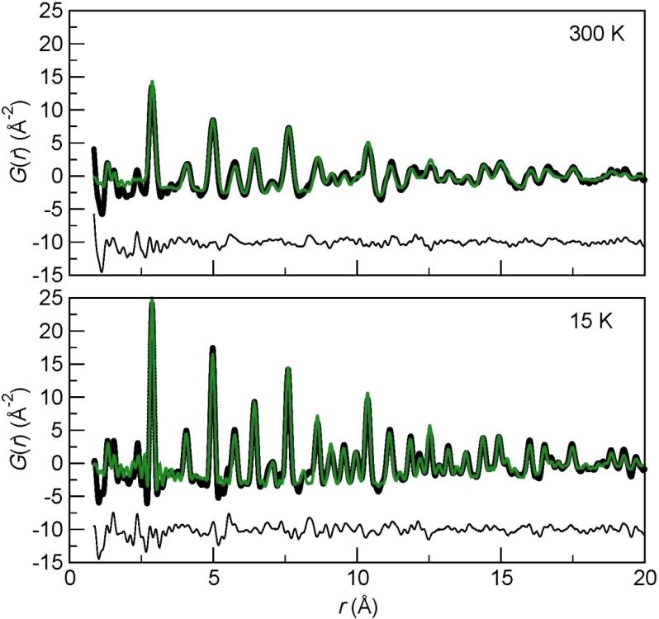
Modeling Au structure & ligand
+
Au-S
CF₃(CF₂ )₅(CH₂ )₂S⁻
300 K: R_{w} = 31.4 %
scale (Au) = 0.2082(5)
scale (molecule) = 0.0485(6)
a (Au) = 4.0755(1)
a(molecule) = 49.40(3)
u_{iso}(Au/molec) = 0.01227(5)
δ1 (Au) = 1.953(7)
srat (molecule)= 0.02(3)
15 K: R_{w} = 24.7 %
scale (Au) = 0.2054(4)
scale (molecule) = 0.0604(6)
a (Au) = 4.06500(5)
a(molecule) = 49.23(2)
u_{iso}(Au/molec) = 0.00433(2)
δ1 (Au) = 2.256(6)
srat (molecule)= 0.03(14)
~1 Mol./110 Å² particle surface
U N C L A S S I F I E D

Slide 26

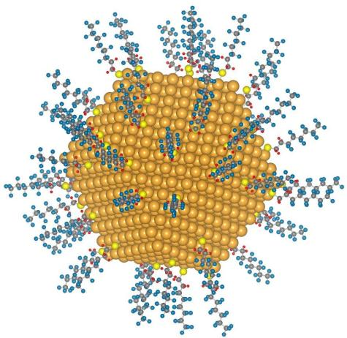
Modeling of nanoparticle data - future !
Using DISCUS/DIFFEV
http://discus.sourceforge.net/
Approach: The particle is modeled as a whole.
Current work on gold nanoparticles: An fcc Au particle is constructed in DISCUS, we select a cuboctahedron.
Ligands (with ‘internal’ structure as constructed with DFT minimization) are located randomly at the particle surface with a defined surface density and defined Au-S distance, orientated out from the particle center.
Evolutionary algorithm is used to refine model parameters above (CPU intensive).
Oxford University
Press, October 2009

Slide 27
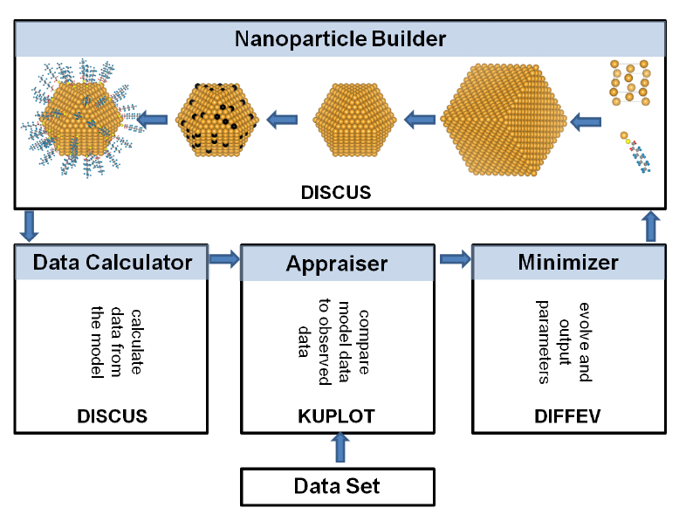

Nanoparticle builder
Page, K., Hood, TC, Proffen, T, Neder, RB, J. Appl. Cryst., 44 (2), 327 - 336 (2011)

Slide 28
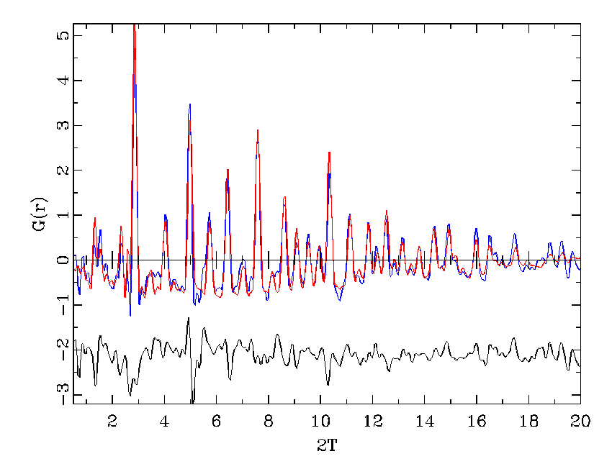
Initial results (in progress ..)
Things to consider
Particle size distribution
Variations in ligands
Ligand-ligand interactions ?
Ligand floppiness
...
r(A)

Slide 29
Experimental
Considerations

Slide 30
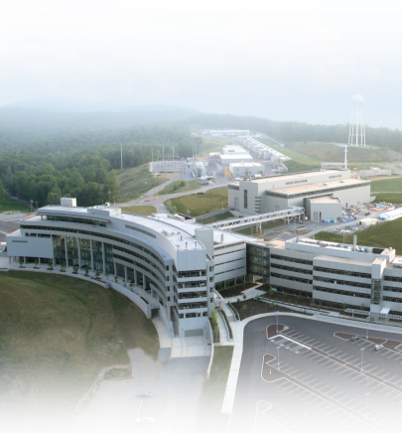
How to obtain high quality PDFs ?
The PDF (similar to the Patterson) is obtained via Fourier transform of the normalized total scattering S(Q):
Requirements to obtain ‘good’ PDF:
High maximum momentum transfer, Q_{max}.
High Q-resolution.
Good counting statistics @ high Q.
Low instrument background
Where ?
Synchrotron sources or Spallation Neutron Sources
(high energy X-rays) (reactor neutron energies are too low)

Slide 31


NPDF: the key to high quality, high r PDFs
The PDF (similar to the Patterson) is obtained via Fourier transform of the normalized total scattering S(Q):
Requirements to obtain ‘good’ PDF:
High maximum momentum transfer, Q_{max}.
High Q-resolution.
Good counting statistics @ high Q.
Low and stable instrument background.

Slide 32

Q resolution ..

Slide 33

Instruments at SNS for PDF studies

Slide 34


MgCo – the power of neutrons and x-rays
PDF peak intensity ∝
where b_{i} is the scattering length of the i^{th} atom.
 | b_{i} for x-ray | b_{i} for neutron
Mg | 12 | 3.631
Co | 27 | 0.779
b_{m}b_{n} | Mg-Mg | Mg-Co | Co-Co
x-ray | 144 | 324 | 729
neutron | 13.18 | 2.83 | 0.607
NOMAD users have access to x-ray PDF measurements through ORNL-APS partner proposal.

Slide 35

Reverse Monte Carlo
RMCprofile
  Atomic configurations ~600 to 20000+ atoms
  Fit both X-ray and neutron F(Q)
  Fit G(r)
  Fit Bragg profile (GSAS ToF 1-3)
  Polyhedral restraints
  Coordination constraints
  Closest approach constraints
Produce a static 3-D model of the structure (a snap-shot in time)
Link: http://www.isis.rl.ac.uk/RMC

Slide 36
Summary
Th. Proffen
Analysis of total scattering gives valuable insight in structure ⇔ properties relationship
High-resolution instruments open the door to medium-range order investigations
Obtain structural information from disordered crystalline, amorphous of composite materials
Use multiple data sets (e.g. x-ray and neutron data) to characterize complex materials
http://totalscattering.lanl.gov

